Slide 1
National Acute Hospital Review
Inpatients & Outpatients

Slide 2
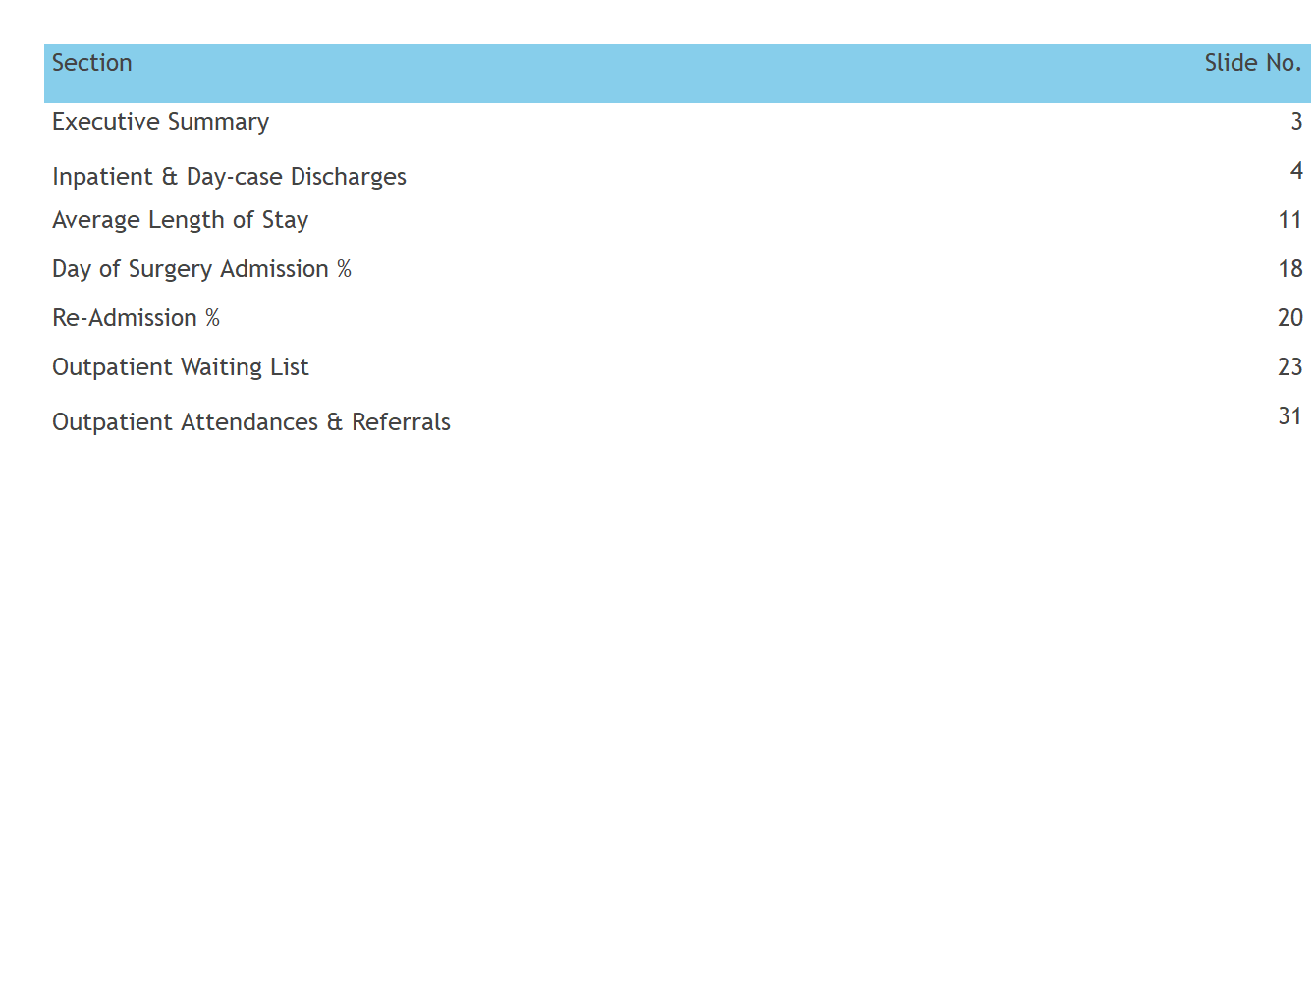
Contents

Slide 3
Executive Summary
KPI | Values | Comments
Surgical IP Discharges | 8,958 | -17% Compared to January 2019
Medical IP Discharges | 22,301 | -15.2% Compared to January 2019
Surgical DC Discharges | 19,824 | -12.6% Compared to January 2019
Medical DC Discharges | 45,512 | -7.5% Compared to January 2019
OP waiting list (Total) | 562,693 | +11.9% since January 4, 2018
OP waiting list (GT 15 months) | 138,411 | +36.3% since January 4, 2018
Waiting up to 12 months | 68.4% (384,674) | Prior Month: 69% (385,352)
Waiting up to 15 months | 75.4% (424,282) | Prior Month: 75.6% (422,296)
Waiting more than 15 months | 24.6% (138,411) | Prior Month: 24.4% (136,258)

Slide 4
Inpatient & Daycase Discharges

Slide 5
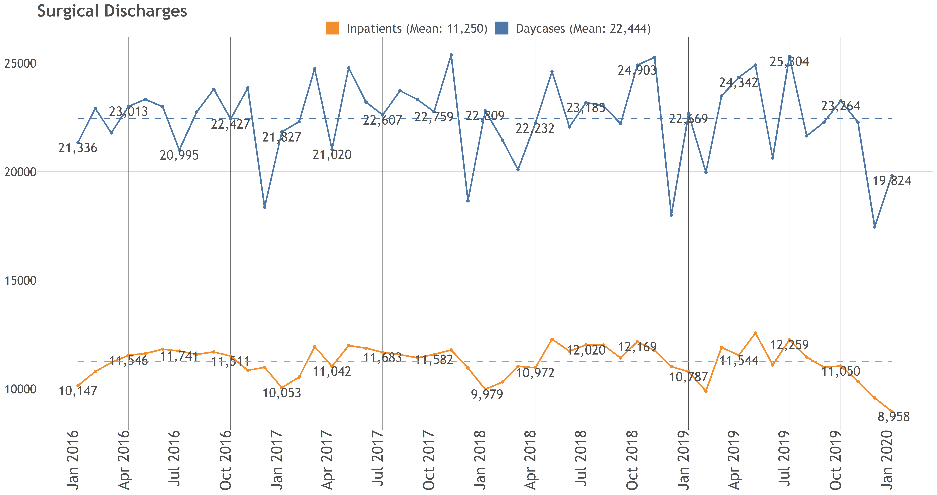
Surgical IP & DC Discharges

Slide 6
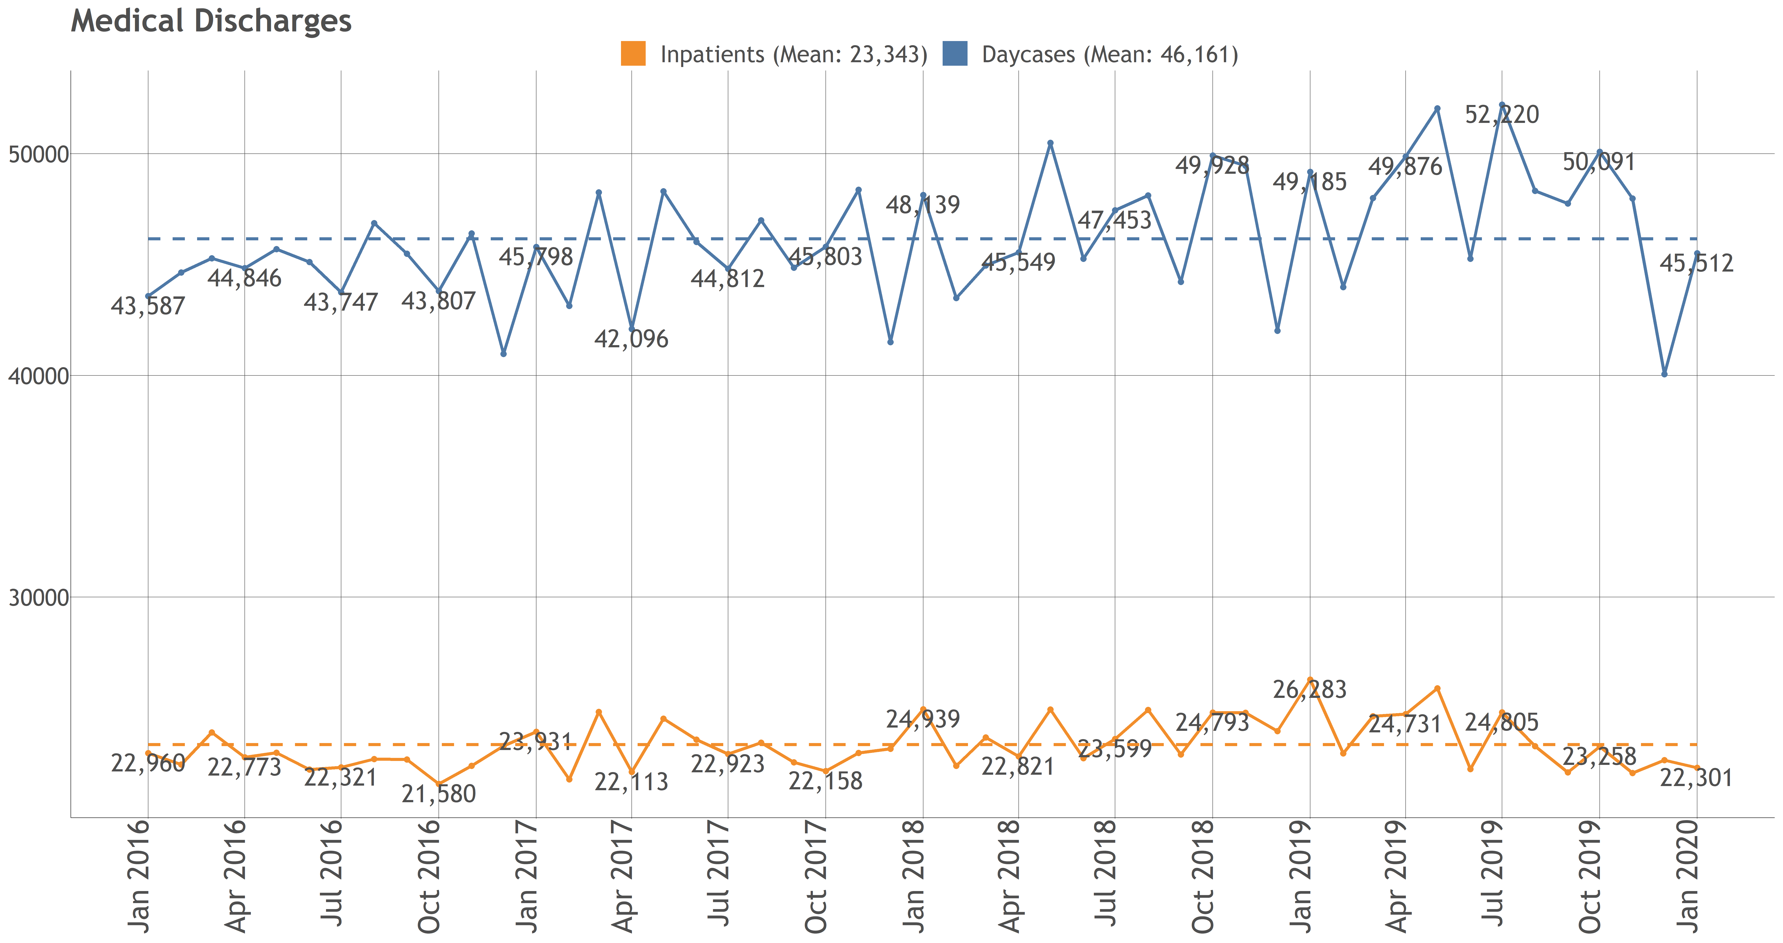
Medical IP & DC Discharges

Slide 7
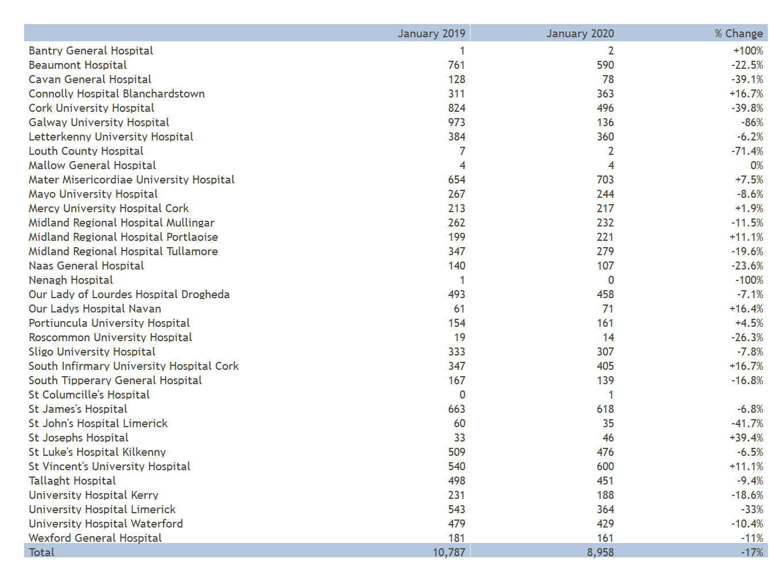
Surgical Inpatient Discharges

Slide 8
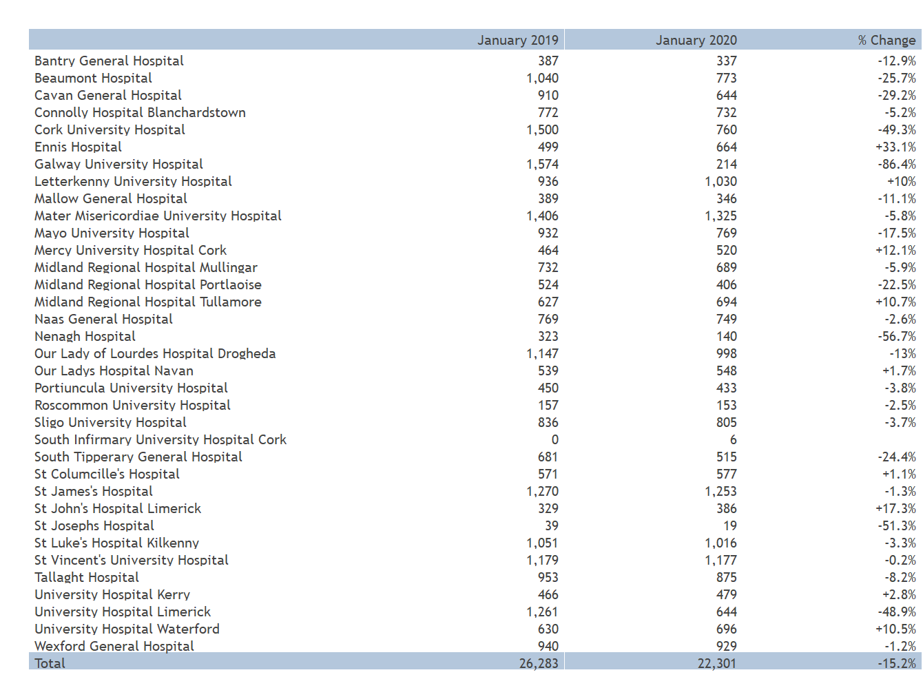
Medical Inpatient Discharges

Slide 9
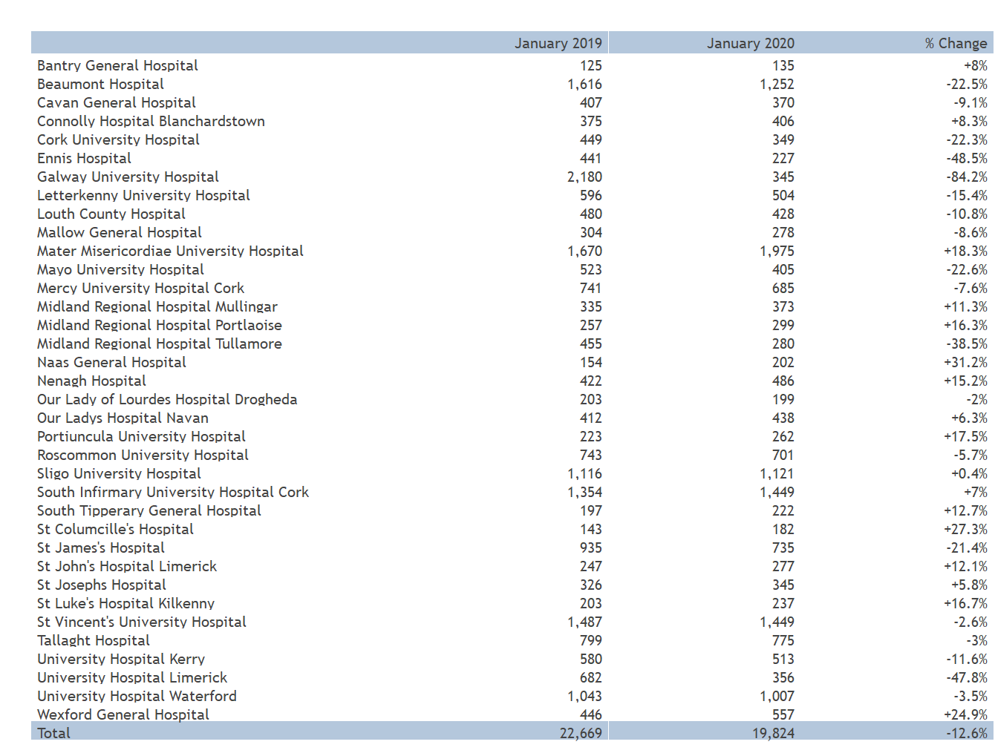
Surgical Daycase Discharges

Slide 10
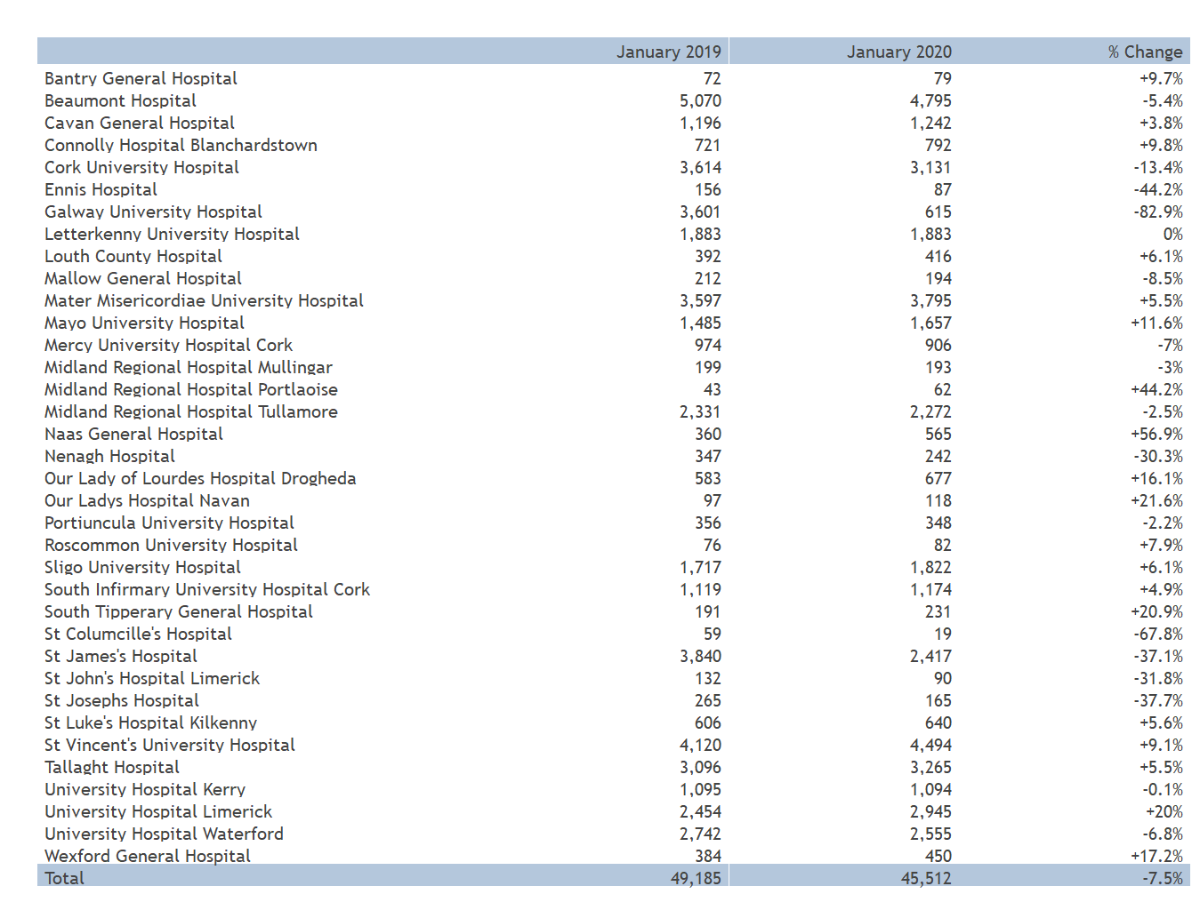
Medical Daycase Discharges

Slide 11
Average Length of Stay

Slide 12
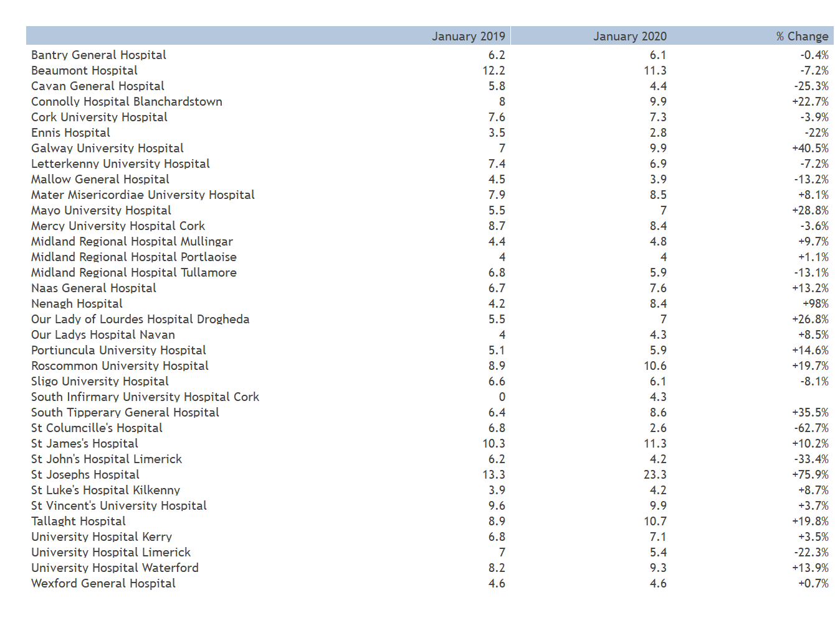
Medical AvLOS

Slide 13
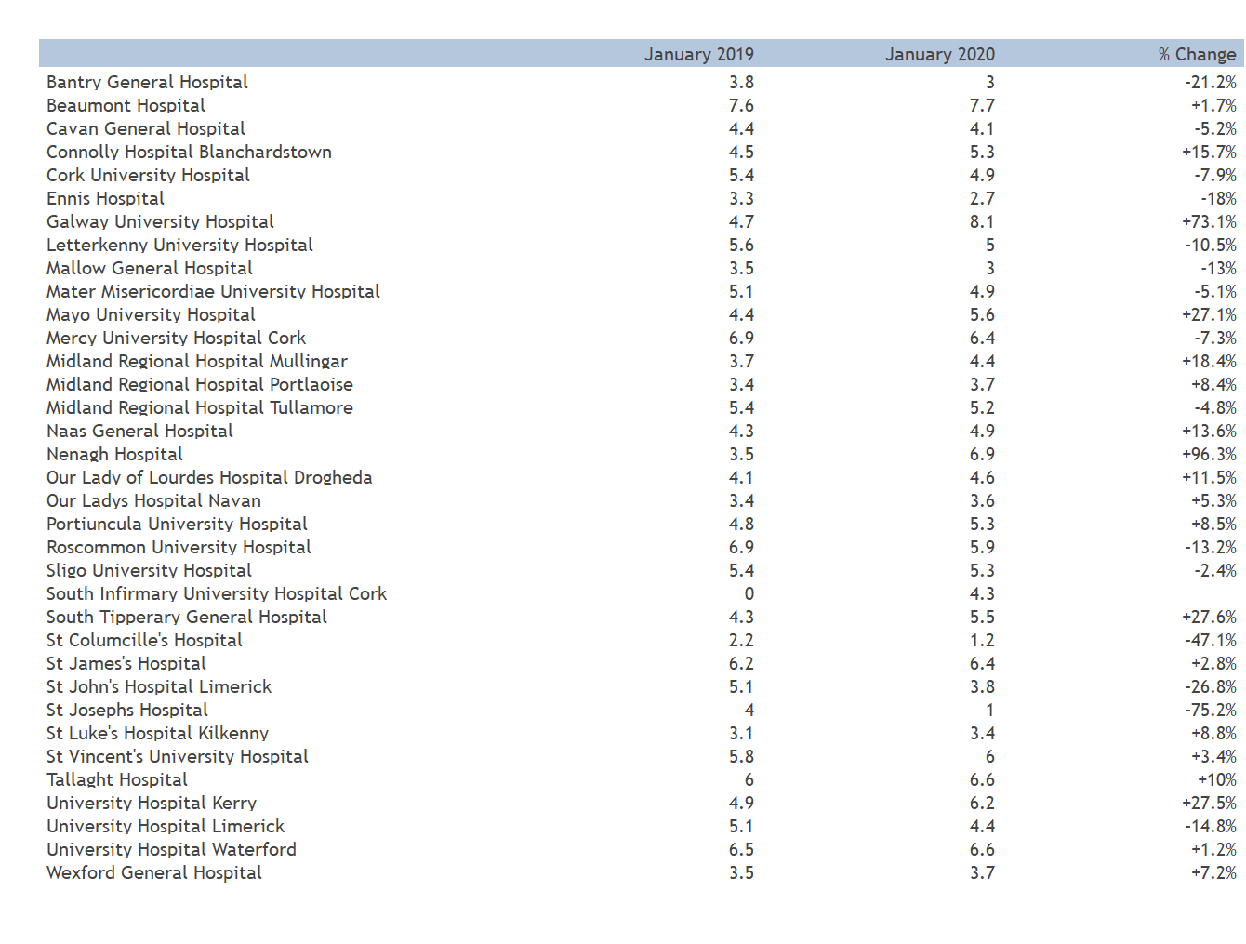
Medical AvLOS (30 Day Stay or Less)

Slide 14
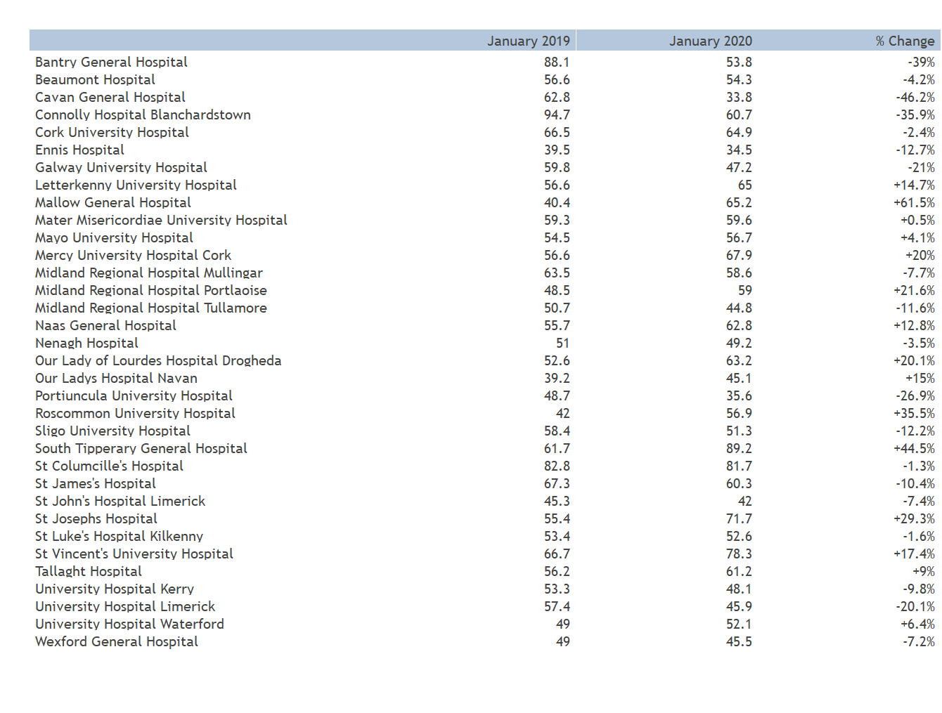
Medical AvLOS (More than 30 Day Stay)

Slide 15
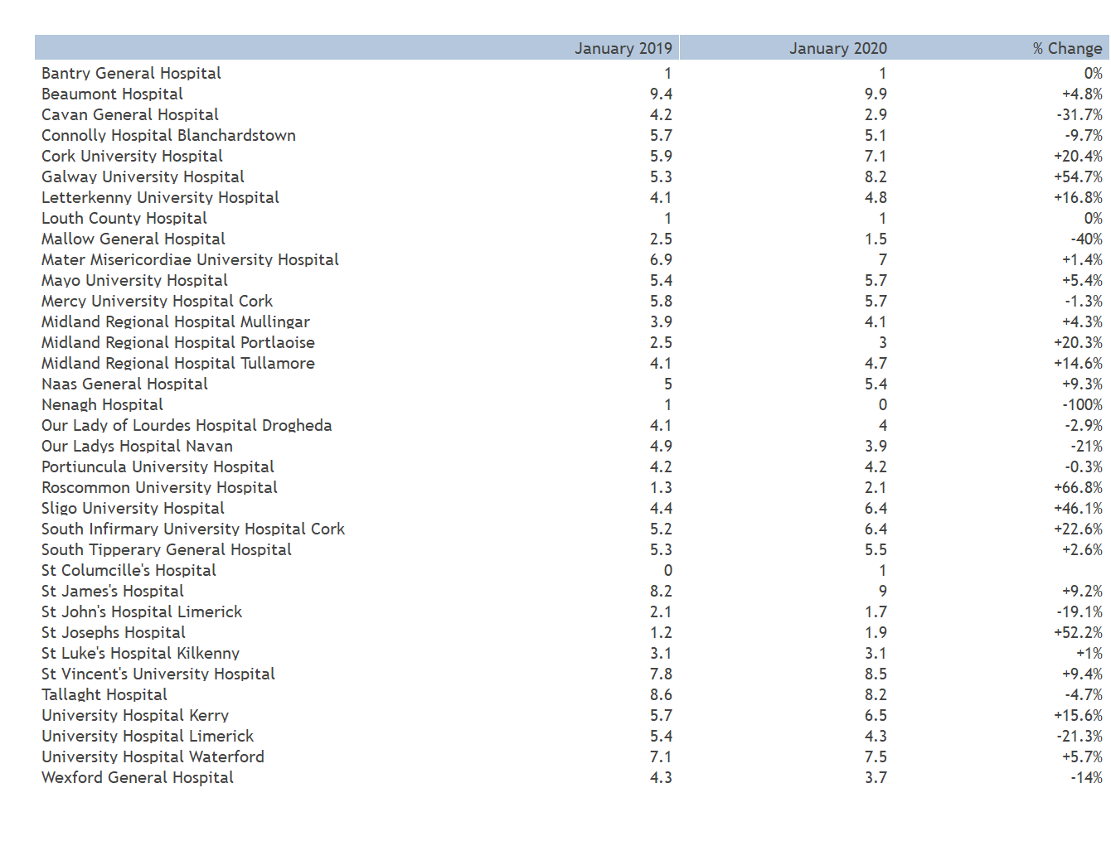
Surgical AvLOS

Slide 16
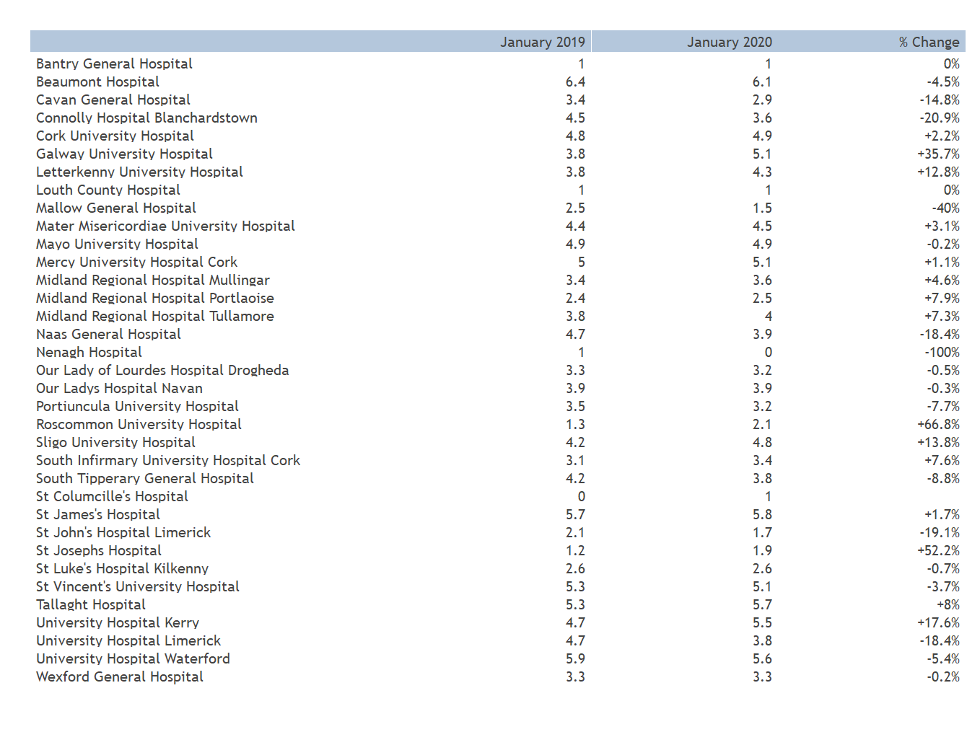
Surgical AvLOS (30 Day Stay or Less)

Slide 17
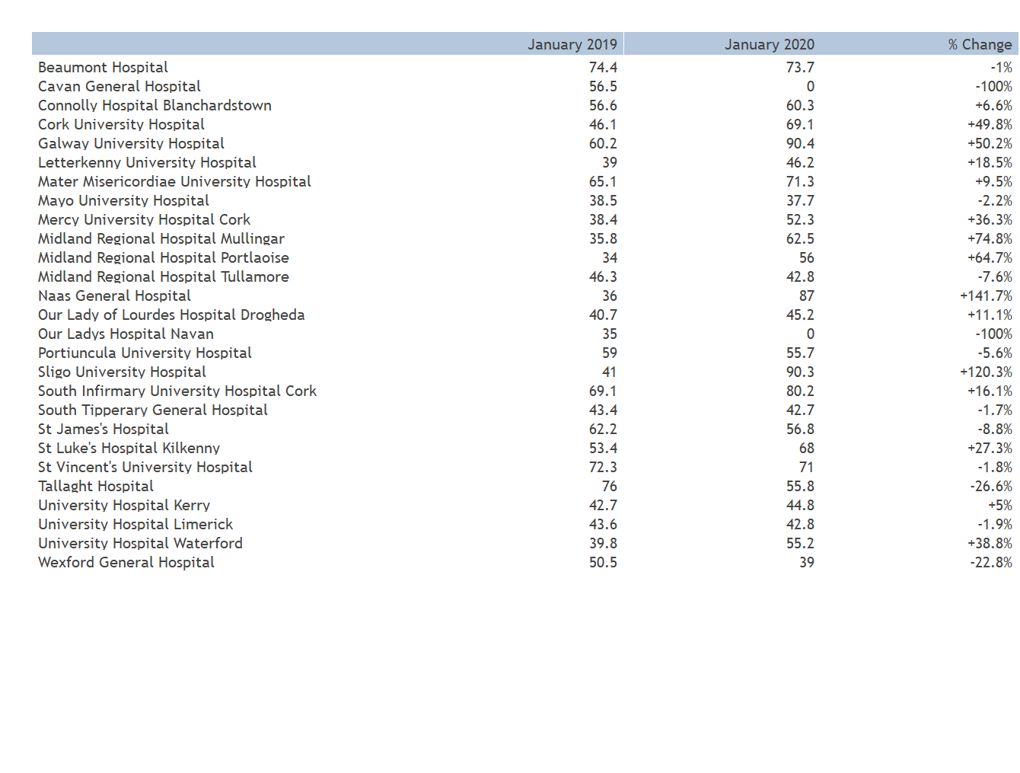
Surgical AvLOS (More Than 30 Day Stay)

Slide 18
Day of Surgery Admission

Slide 19
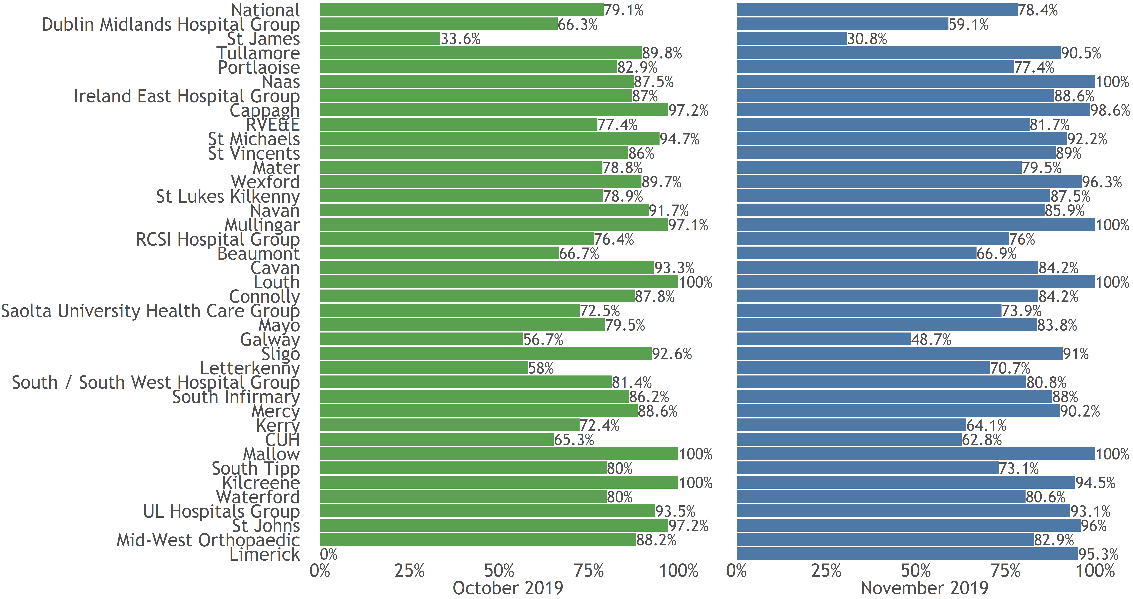
DOSA % by Hospital

Slide 20
Re-Admission %

Slide 21
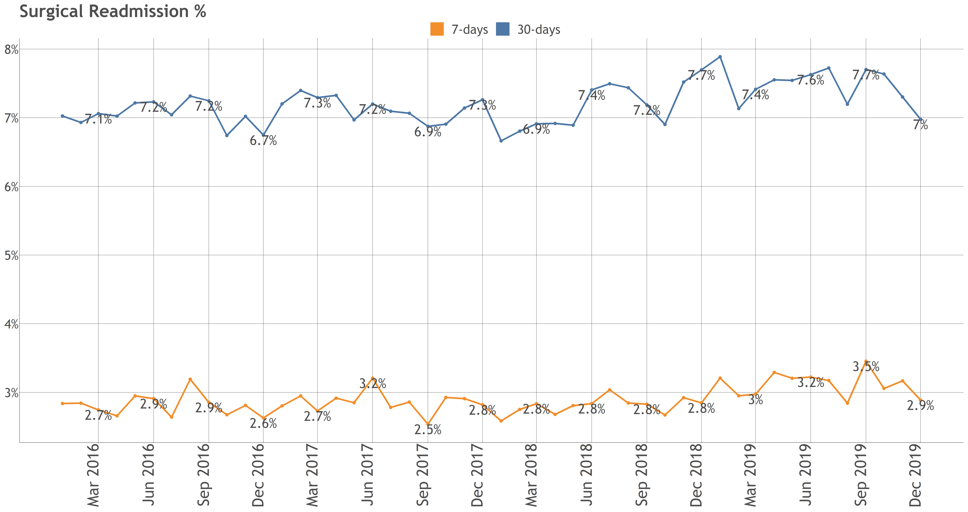
Surgical Re-Admission %

Slide 22
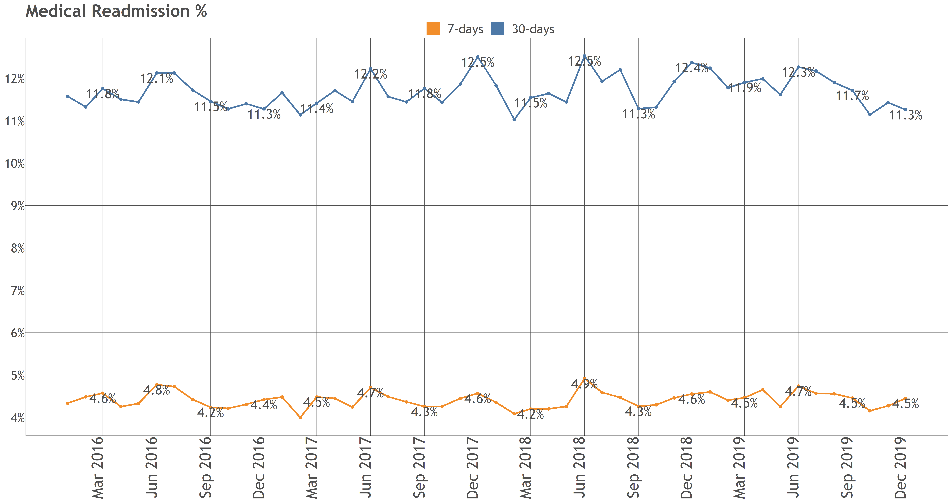
Medical Re-Admission %

Slide 23
Outpatient Waiting List

Slide 24
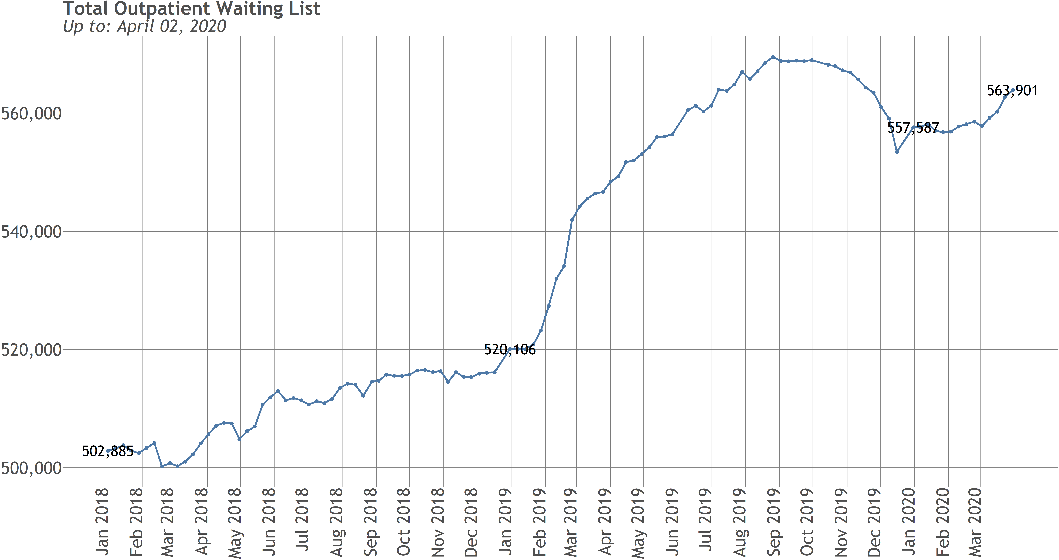
Total Waiting List Trend

Slide 25
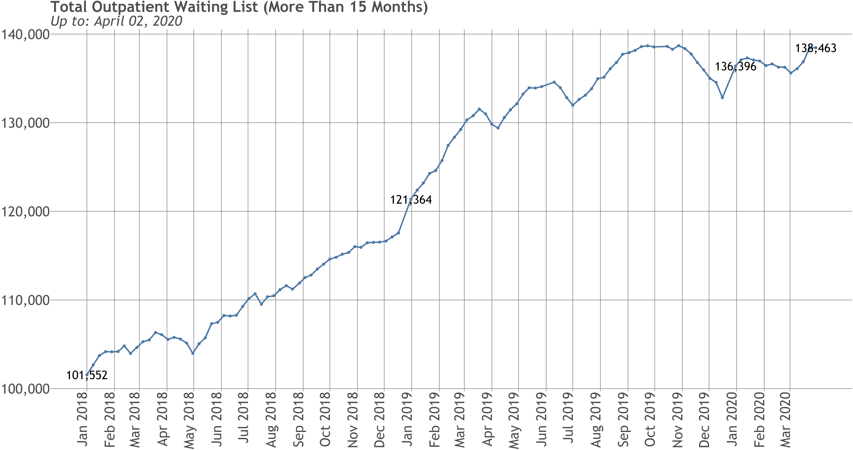
Total Waiting List (+15 Months) Trend

Slide 26
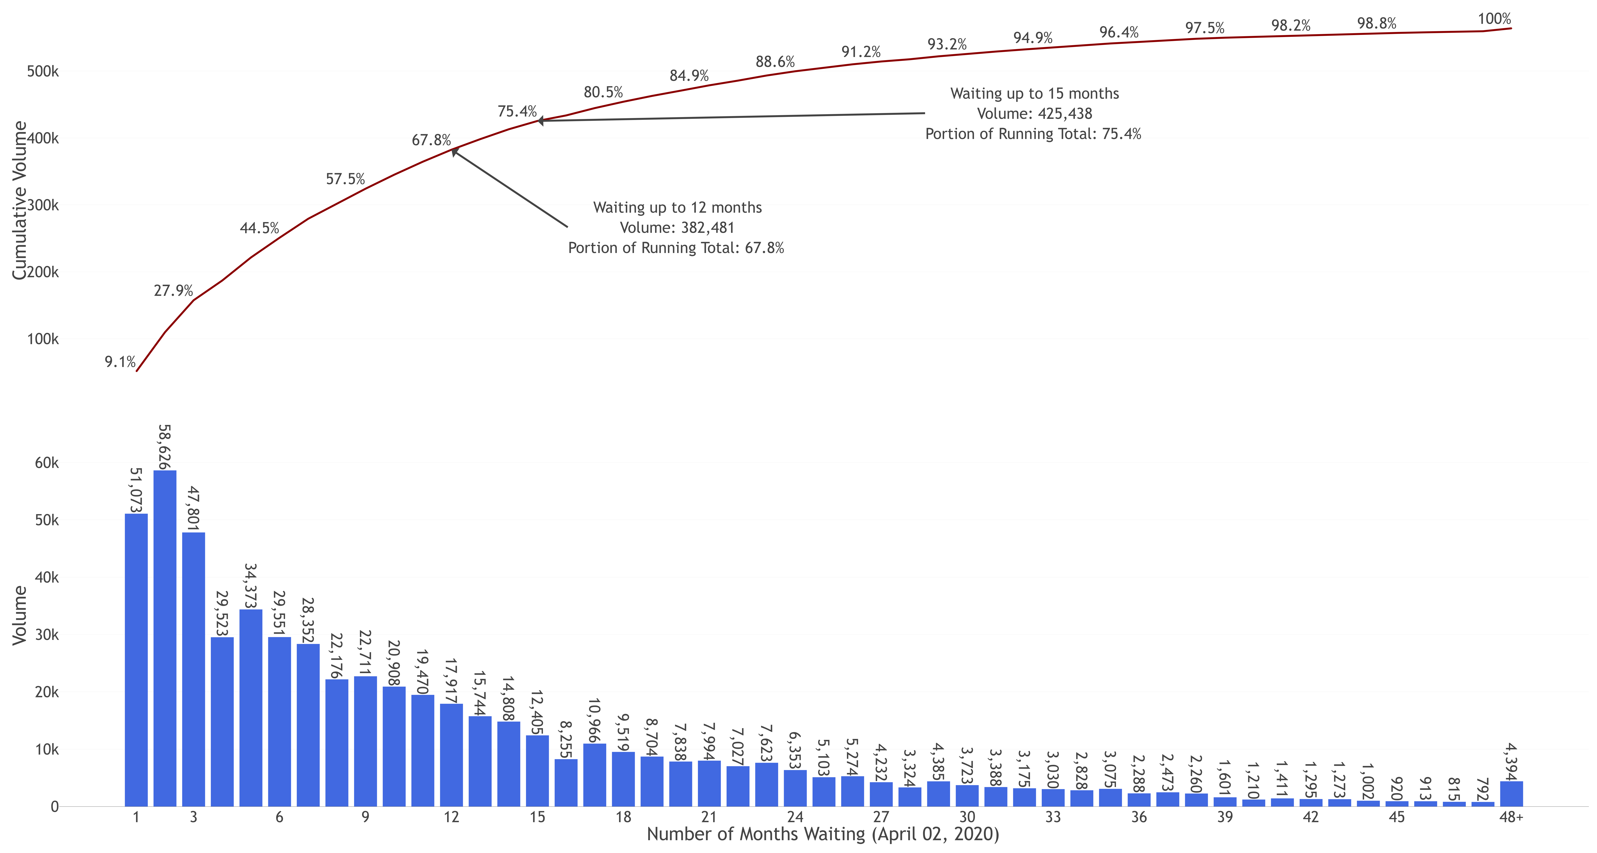
Waiting List Distribution

Slide 27
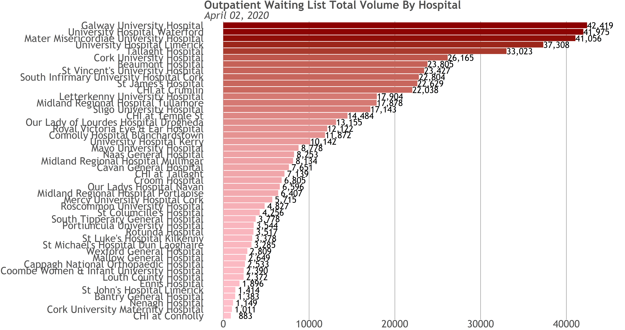
Waiting List by Hospital

Slide 28
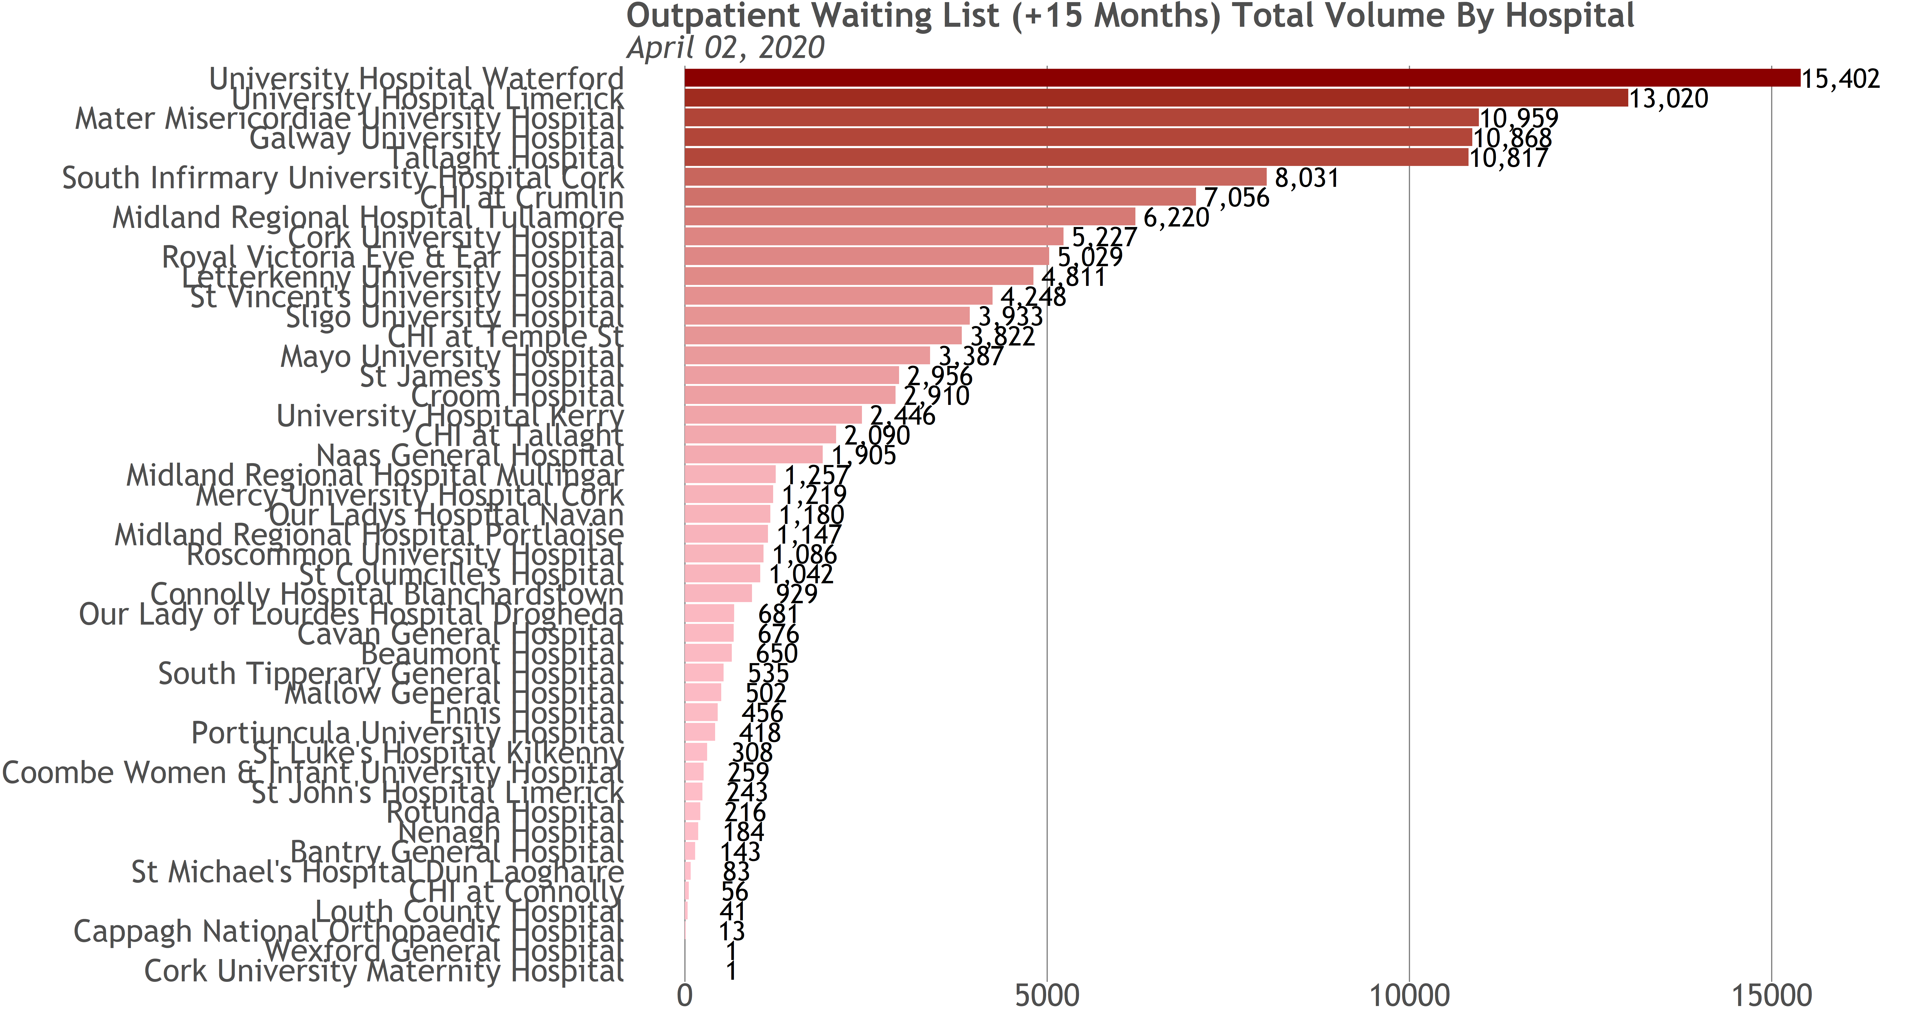
Waiting List (+15 Months) by Hospital

Slide 29
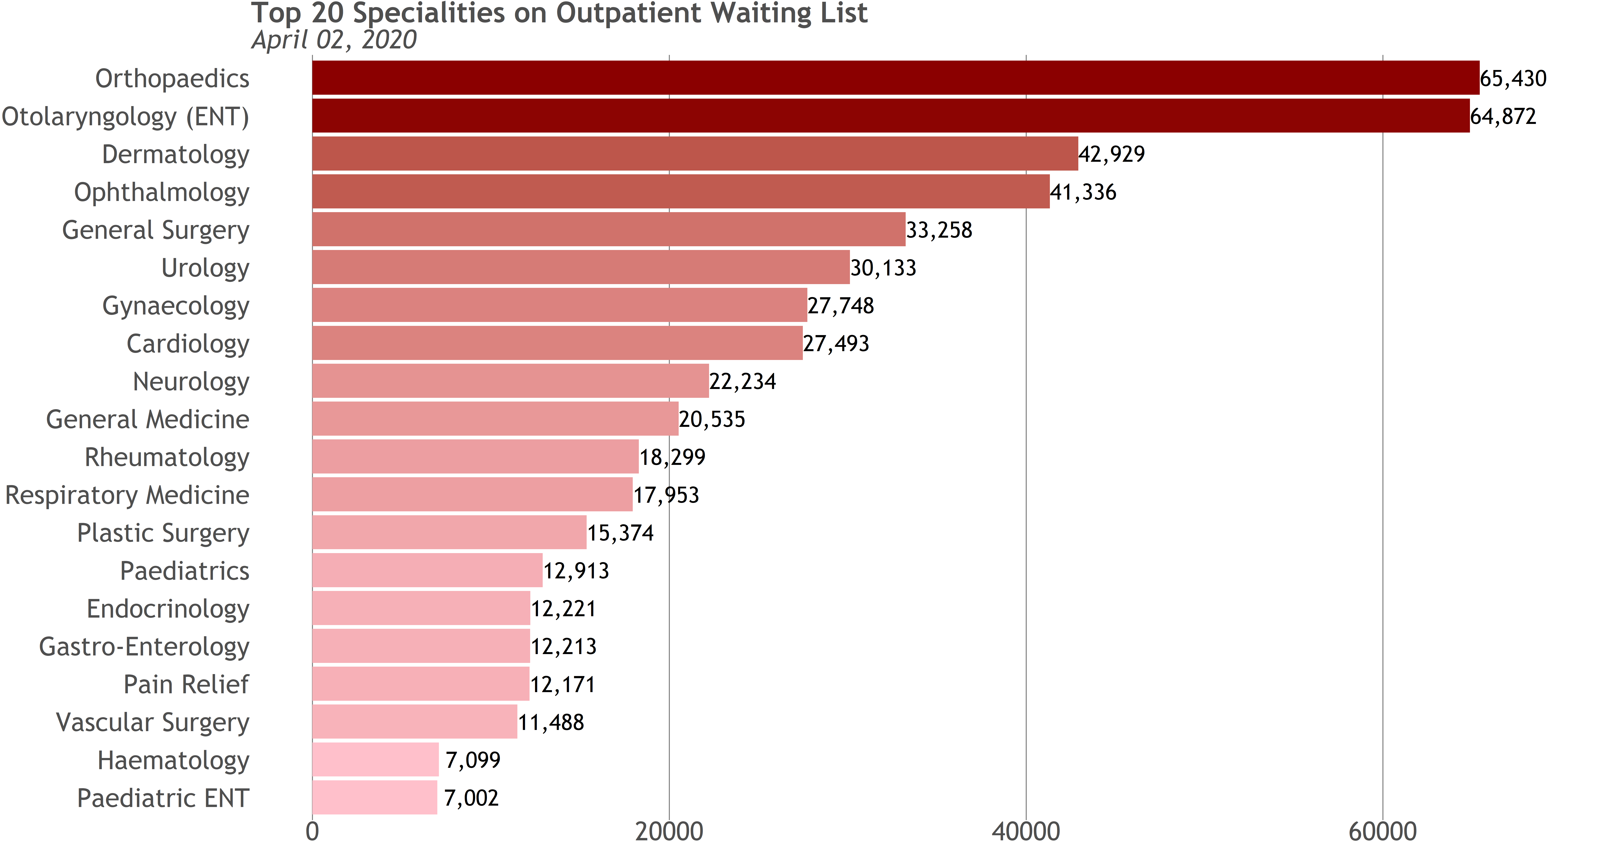
Waiting List by Specialty

Slide 30
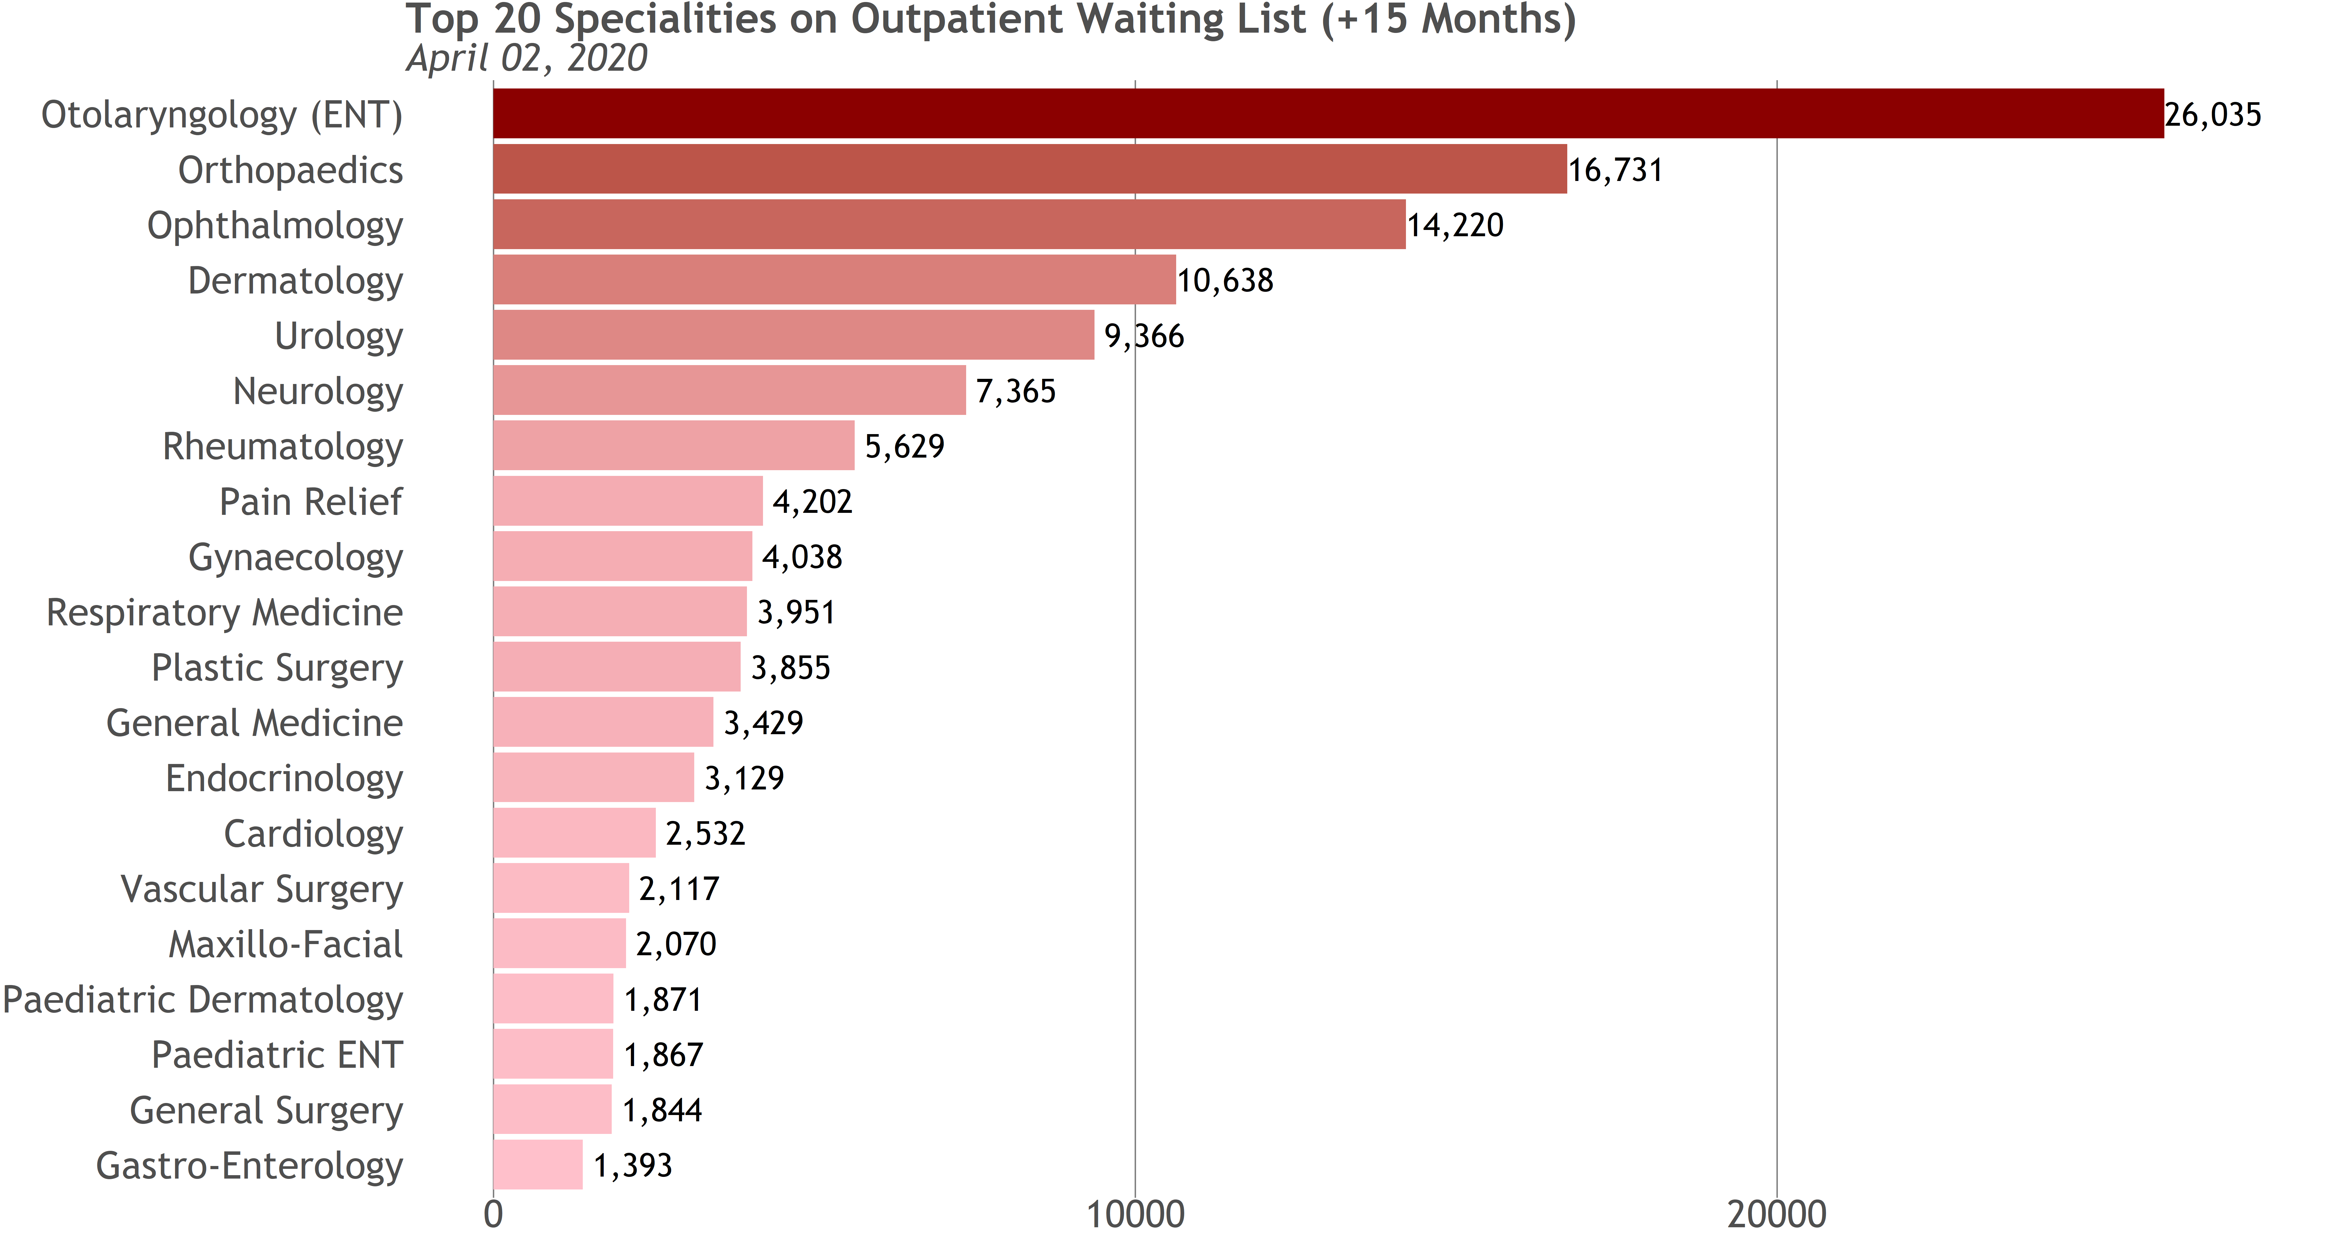
Waiting List (+15 Months) by Specialty

Slide 31
Outpatient Attendances & Referrals

Slide 32
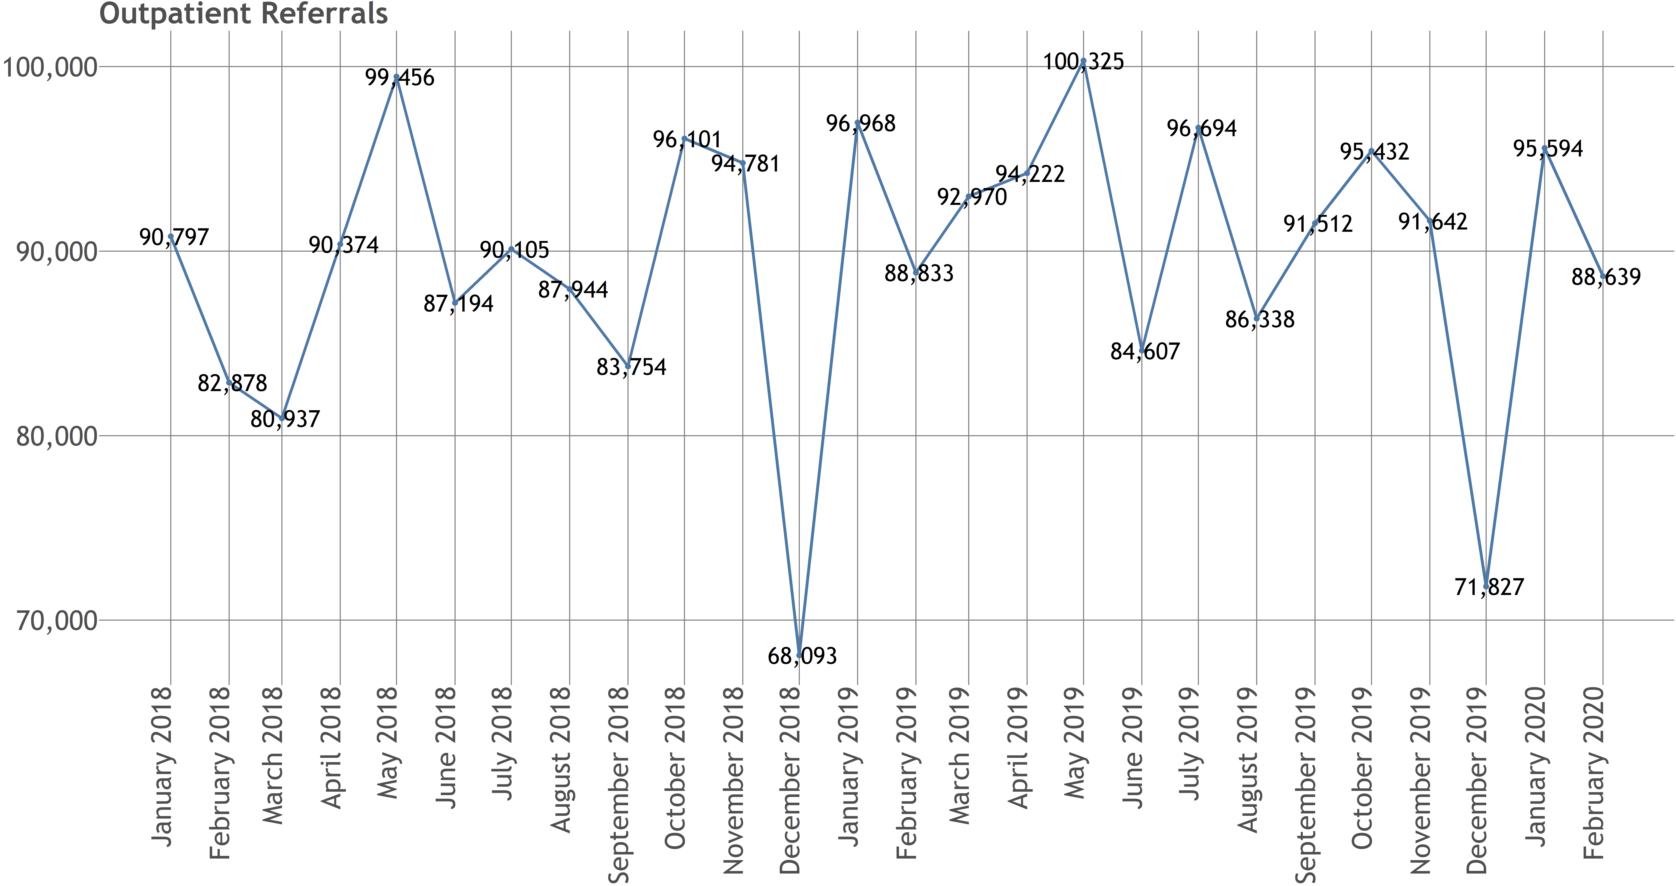
Referrals Trend

Slide 33
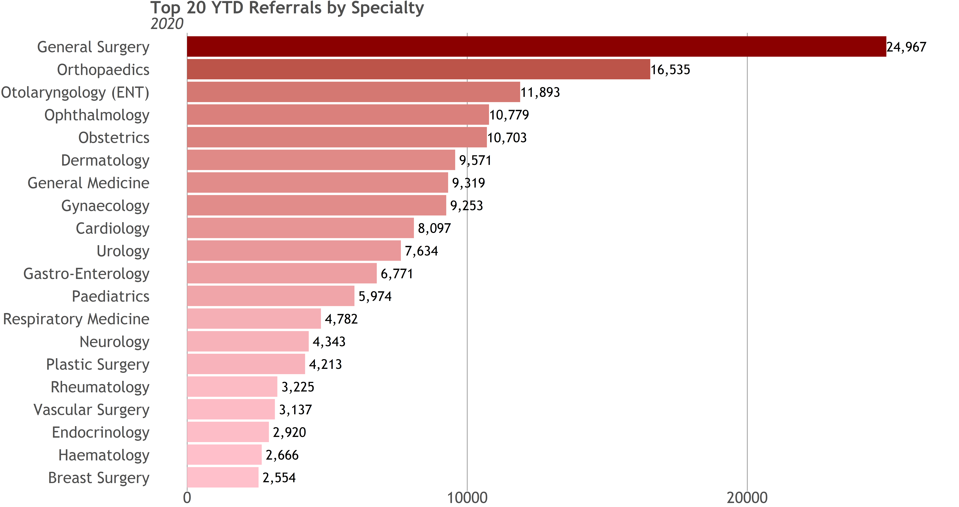
YTD Referrals by Specialty

Slide 34
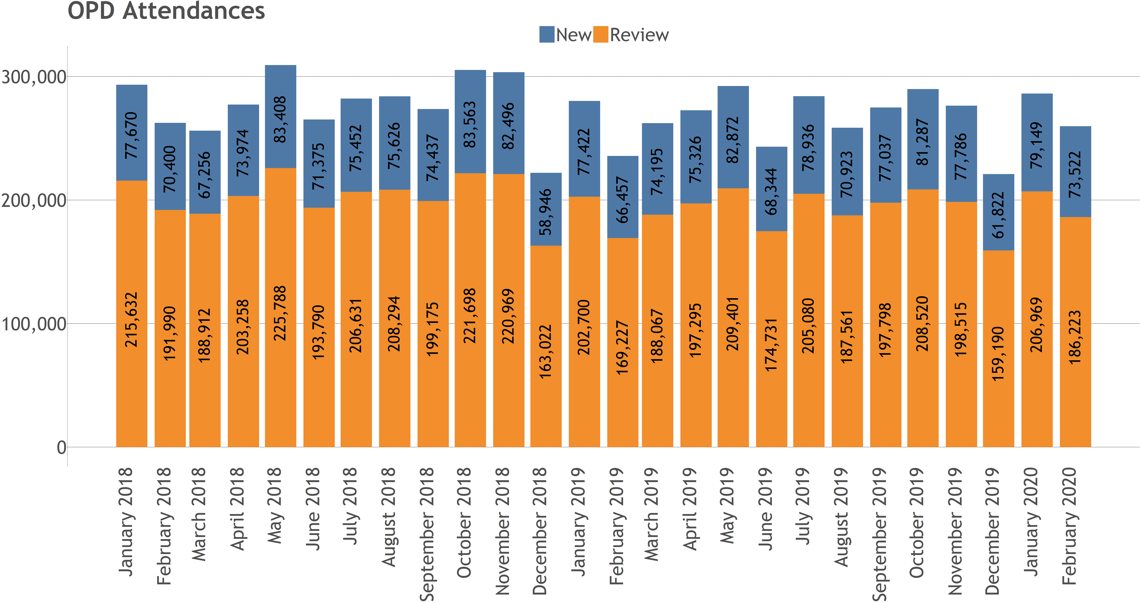
New & Review Attendances Trend

Slide 35
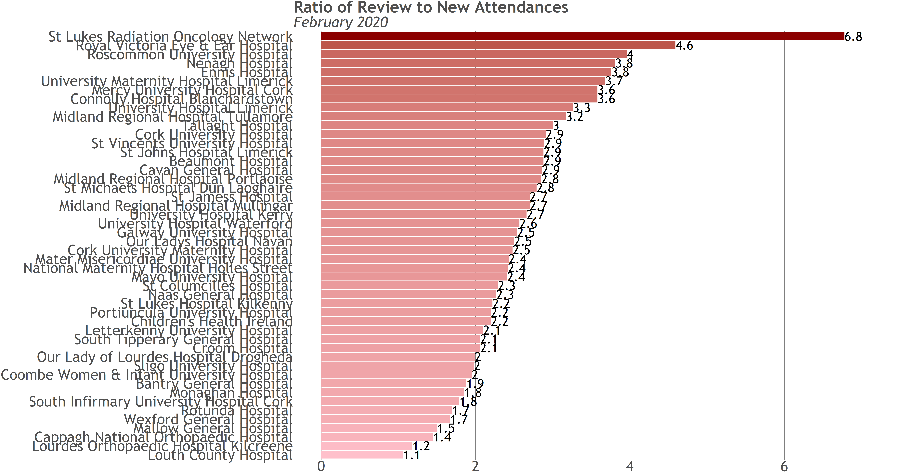
Review to New Ratio by Hospital

Slide 36
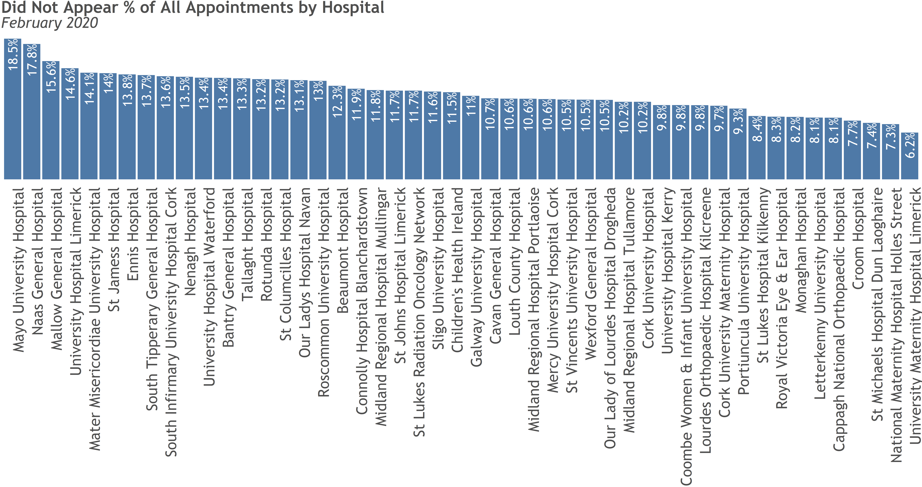
Did Not Appear % by Hospital

Slide 37
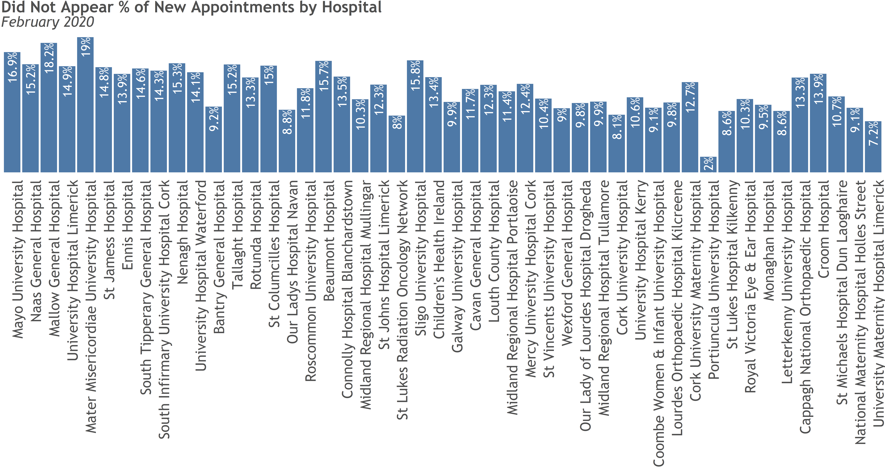
New Did Not Appear % by Hospital

Slide 38
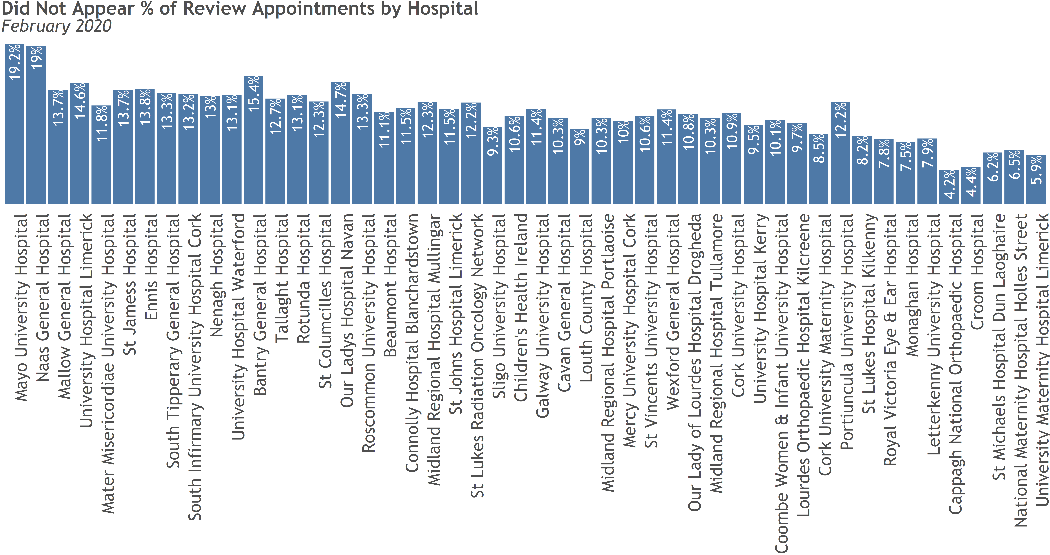
Review Did Not Appear % by Hospital

